Slide 1

Covid19 in Germany
The fight against an unkown pandemic

Slide 2

Two targets for the fight against the pandemic
Social security for those in need
Supporting the economy whereever necessary
Every measure as a joint effort by:
the state, the 16 federal states and the municipalities with representatives from all parts of society

Slide 3
About the Protective Shield
The biggest economically program after WW II
353 bill € as budget relevant spendings and
820 bill € as garantees
How is it spent (examples)?
Vaccine and protective material
loss of earnings for families during school closing
50 bill € for small enterprises, self-employed-entrepeneurs
no insolvencies till the end of 2020
600 bill. € for big player
Freelancer to postpone tax duties
Lowering VAT
Short-time allowance
240 bill. € credits for memberstates
200 bill. € liquidity for s & m enterprises
100 bill. € short time allowance
to developing countries
central state of Germany and the federal states
EU answer to the pandemic
part of international
cooperation (G 20)

Slide 4
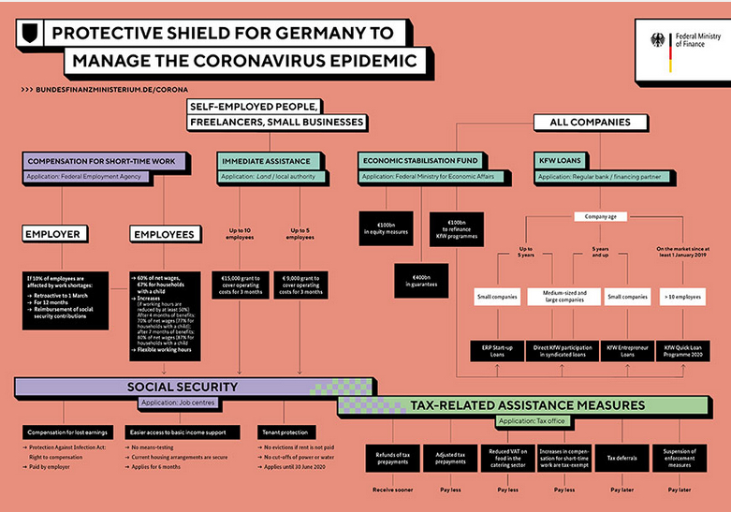
https://www.bundesfinanzministerium.de/Content/EN/Bilderstrecken/Media_Centre/Graphics/2020-04-14-corona/infographics-protective-shield.jpg?__blob=poster&v=4

Slide 6
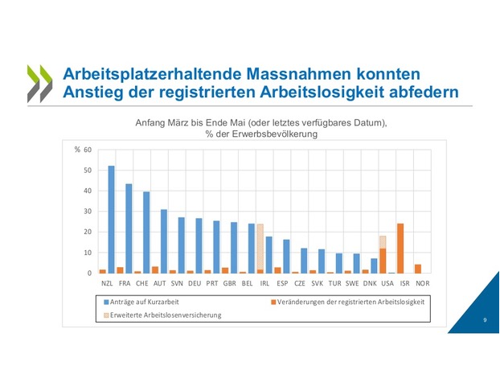
Short time work
to avoid high unemployment rates

Slide 7

Few more details about
Short Time Work (STW) Allowance

Slide 8

What exactly is
Short Time Work (STW)?
Without this instrument:
The employer has to pay, even if he does not have work or not enough work to keep his employees busy
In case of crisis this might lead to bancruptcy and the loss of all jobs

Slide 9

What are the prerequisites?
STW does not leverage the usual economical responsibility and risks of employers.
Each month, STW ist used, there must be:
a substantial work shortage,
caused by economical reasons or unavoidable circumstances,
transitory,
unavoidable for the employer,
affecting at least 1/3 of the employees with at least 10% loss of wage.

Slide 10

Who can benefit vom STW allowance?
Anyone, who paid Social Security Contributions for the Unemployment Insurance, if his employer has at least one branch office in Germany.
Yes: full and part-time employees, no matter whether the labour contract is indefinite or of limited duration
apprentices
No: employees of a „Mini-Job“ (€ 450,00)
temporary employees
solo self-employed persons

Slide 11
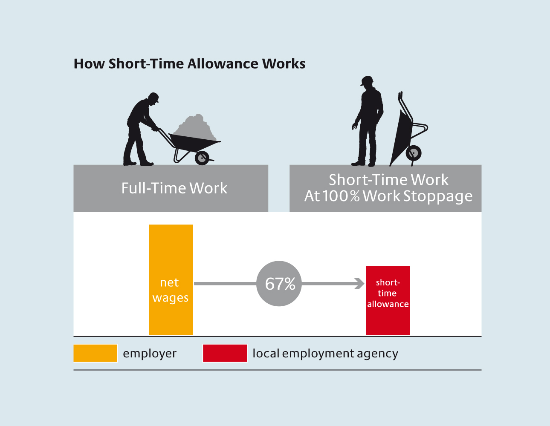
How STW works with 100% work shortage?

Slide 12
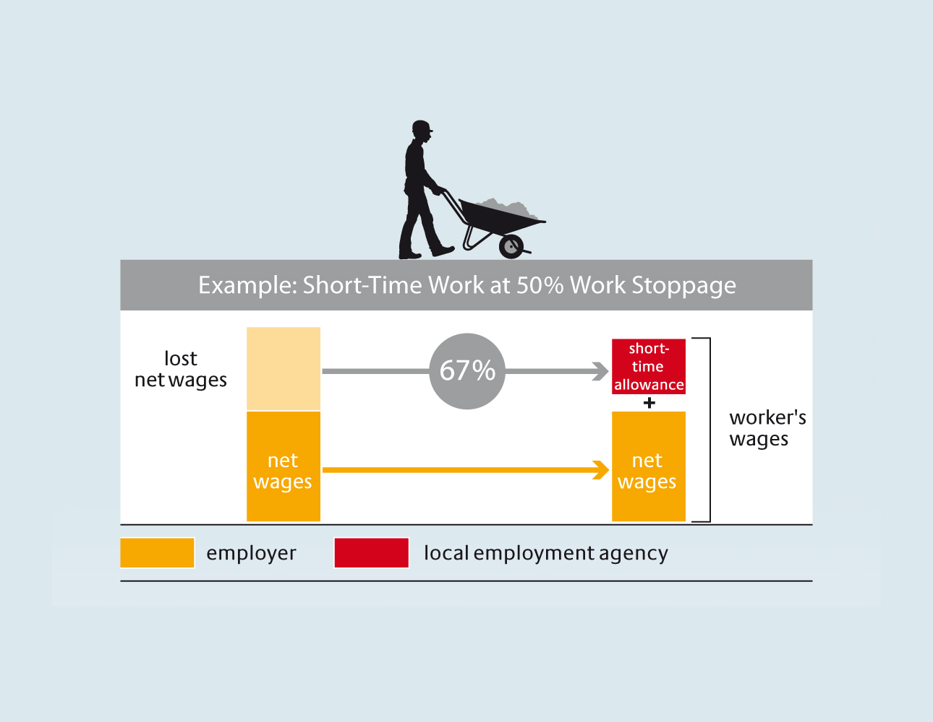
How STW works with 50% work shortage ?

Slide 13
Adaptions of the scheme to Covid-19 Pandemic
STW is possible, if 10% (instead of 1/3) of the employees suffer at least 10% wage loss because of work shortage.
Leave must not be taken and flextime wage record must not be used to fill up a negative balance.
the duration for SWT has been prolonged from 12 to up to 24 month.
100% of the contributions to Social Security paid for by the employer are reimbursed to him.
STW allowance will be raised to 70/77% after three and 80/87% after six months of STW, if the wage loss is at least 50%.
Employees in STW may take up another job. Only income, which surpasses 100% net income in times without STW will be deducted.
STW is avaible to temporay employees also.

Slide 14
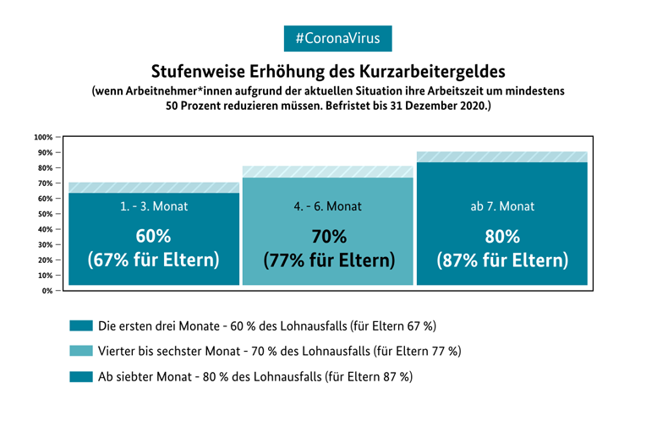
2021
Month 1 - 3
Month 4 - 6
from the 7. month
parents
parents
parents

Slide 15
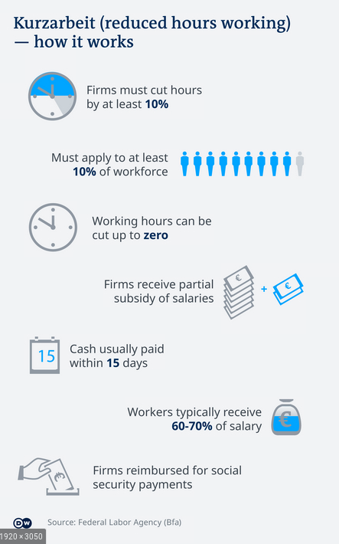

Slide 16
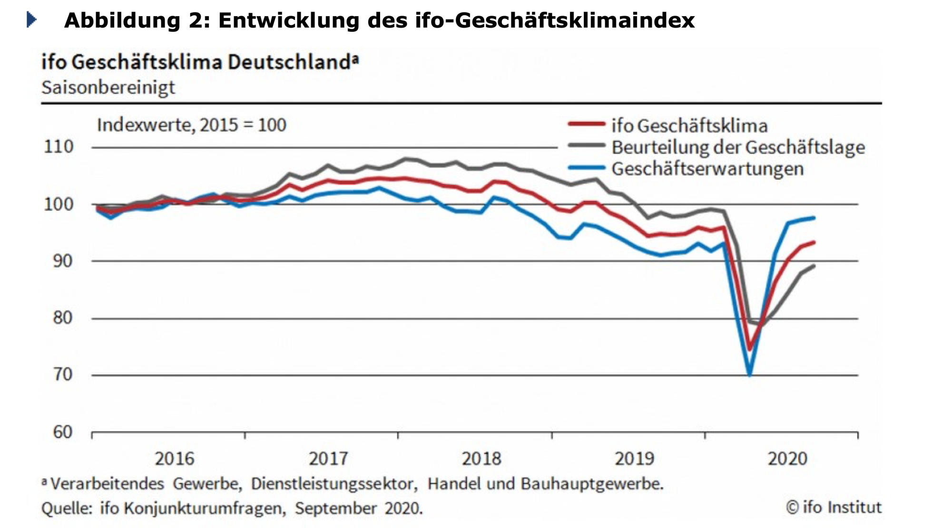

Slide 17
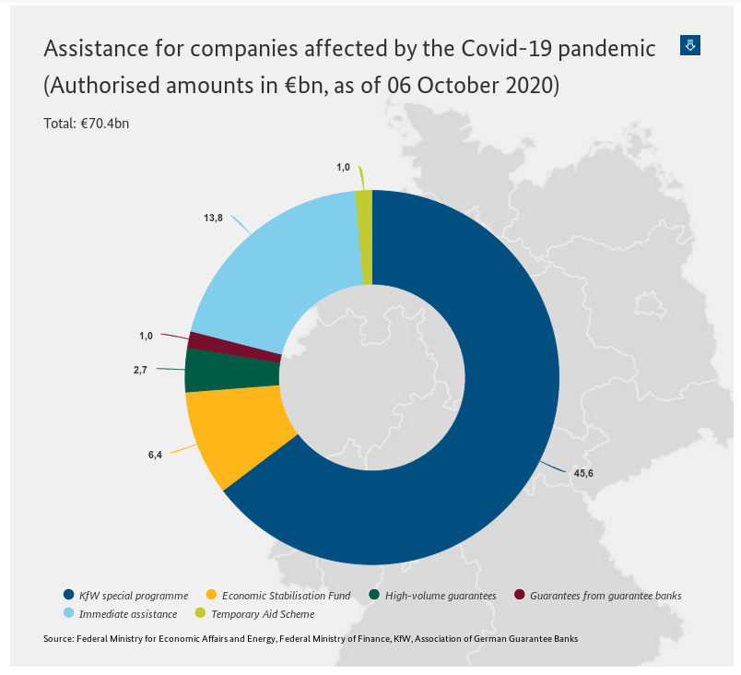
Key fig­ures: up­date
The protective shield to manage the coronavirus pandemic is the largest assistance package in the history of the Federal Republic of Germany. The package ensures that targeted assistance is quickly provided to those who need it. Assistance totalling €70.4bn has already been approved (as of 06 October 2020). This consists of the KfW special programme (€45.6bn), immediate assistance for small businesses, self-employed individuals and freelancers (€13.8bn*), the Economic Stabilisation Fund (€6.4bn), guarantees from guarantee banks (€1.0bn) and high-volume guarantees (€2.7bn). About 124,300 applications with a total volume of around €1.5bn have already been submitted for assistance under the recently launched temporary aid scheme for small and medium-sized businesses. Assistance totalling €982m has already been approved.
*Resources from the Federation.

Slide 18
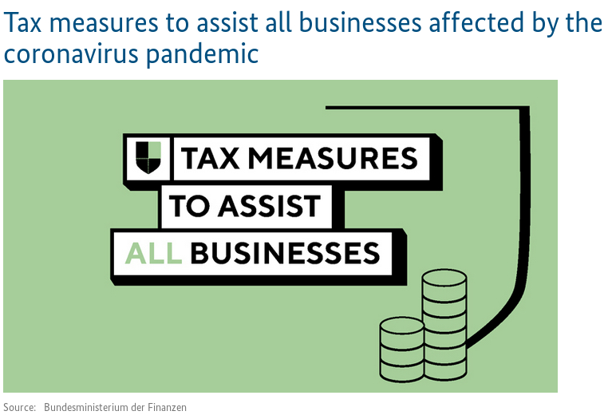
https://www.bundesfinanzministerium.de/Content/EN/Standardartikel/Topics/Priority-Issues/Corona/2020-03-20-Tax-measures-to-assist-businesses.html

Slide 19
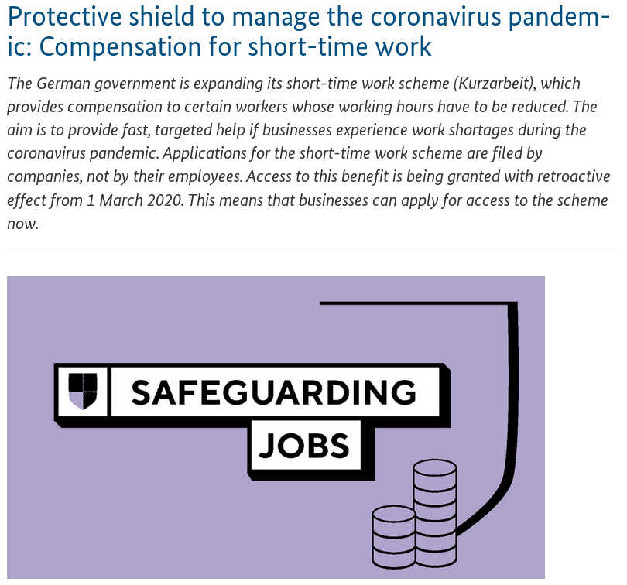
https://www.bundesfinanzministerium.de/Content/EN/Standardartikel/Topics/Priority-Issues/Corona/2020-03-24-protective-shild-short-time-work.html

